Slide 1
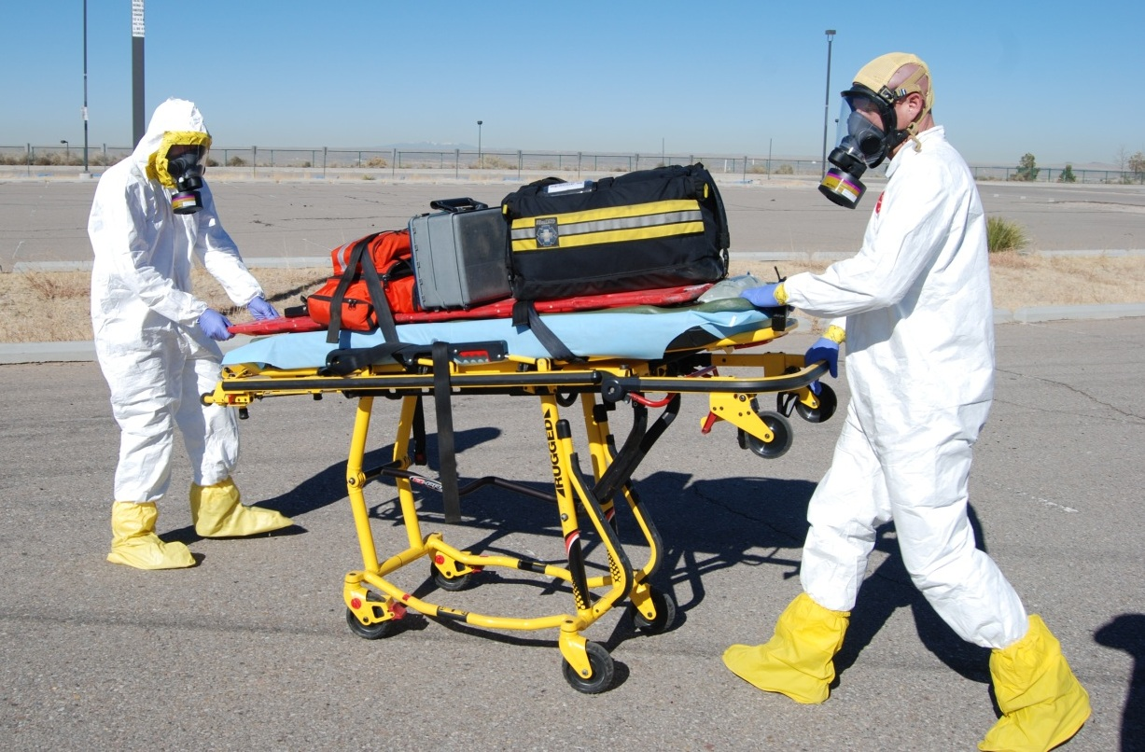
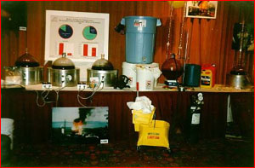
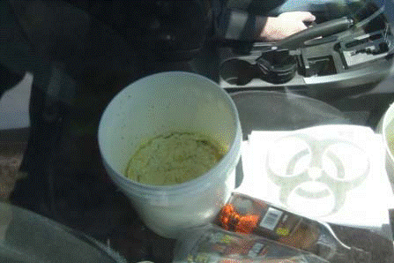
MATERIALS
HAZARDOUS
photo from: bernco.gov
2018 In-Service Law Enforcement Training

Slide 2

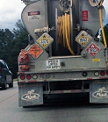

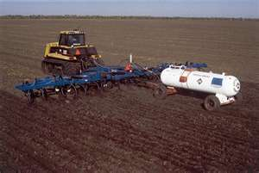
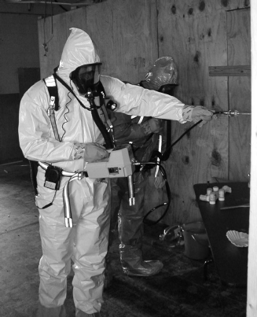


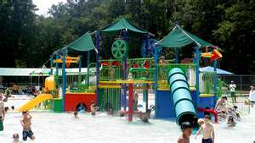
Hazardous Locations
warehouse districts
interstates
farms
clandestine labs

Slide 3
Training Objectives
Define “hazardous materials” and the risks associated with them during a hazardous materials incident.
Describe the duties of an awareness-level first responder at the scene of a hazardous materials incident.

Slide 4
Training Objectives
List methods used to recognize the presence of a hazardous material, to include the identification of the possible material or substance based on readily available clues.
Demonstrate the ability to use the DOT Emergency Response Guidebook in identifying a hazardous material and appropriate first responder actions, to include notifying additional resources.

Slide 5
Training Objectives
Explain what WISER is and how to use it as a resource when at the scene of a suspected hazardous materials incident.
Identify the occurrence of a natural gas leak and what protective measures to take to assure life safety until the leak can be mitigated.

Slide 6

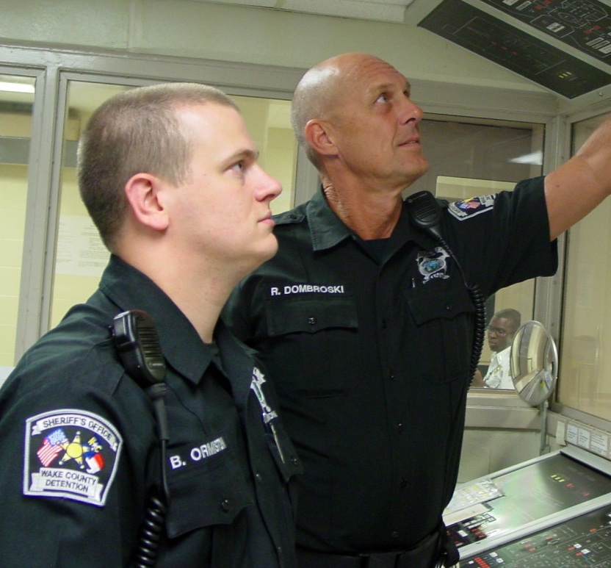

Save Lives
Protect Property

Slide 7
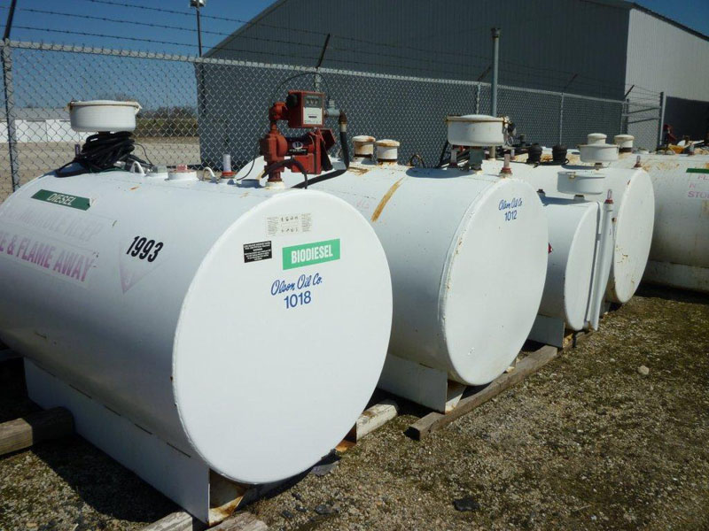
Occupational Safety & Health Administration
photo from: olsonoil.com

Slide 8
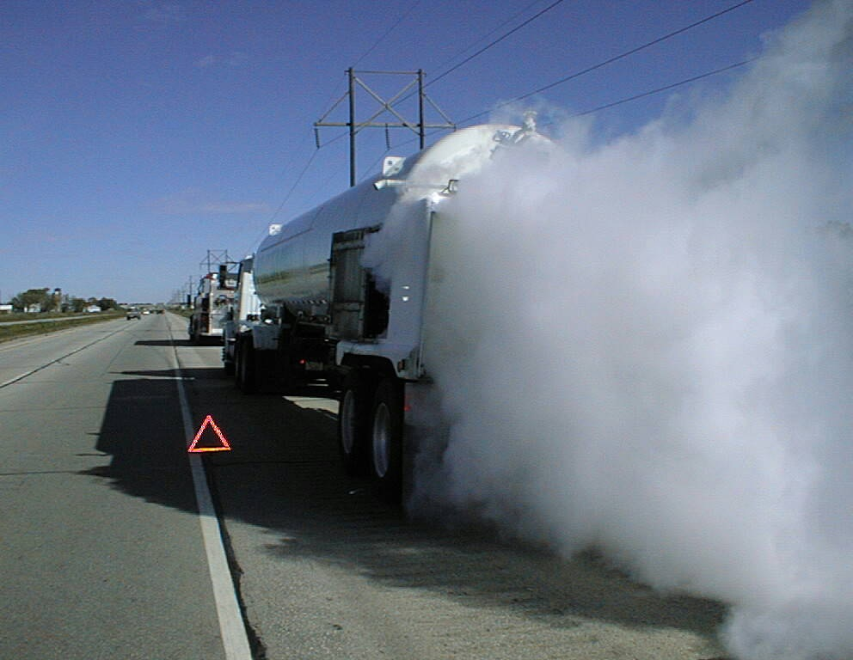
Department of
Transportation

Slide 9
DOT Hazard Classes
Explosives
Toxic Materials
Compressed Gases
Radioactive Material
Flammable Liquids
Corrosive Substances
Flammable Solids
Miscellaneous
Oxidizers and Organic Peroxides

Slide 10

Awareness-level Responsibilities
OSHA HAZWOPER Standard 29 CFR 1910.120

Slide 11

Initial Tactics
Become familiar with the ERG
Resist rushing in
Approach incident from upwind
Stay clear of spills, vapors, fumes, smoke, or other suspicious sources

Slide 12
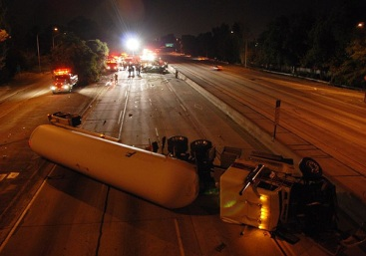
Recognition Tips
Be aware of indicators from your senses
Placards
Shipping papers/ SDS
Observe the surroundings
Unlabeled containers with other indicators/ persons exhibiting symptoms of exposure
Location of buildings
Container shapes and construction
photo from: lafd.blogspot.com

Slide 13


Emergency Response Guidebook
Yellow Pages
Blue Pages
Orange Pages
photo from: youtube.com
Green Pages

Slide 14
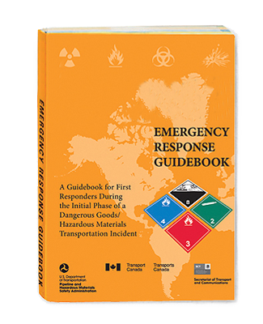



Using the Guidebook
Step 1
Step 2
Step 3

Slide 15

WISER

Slide 16

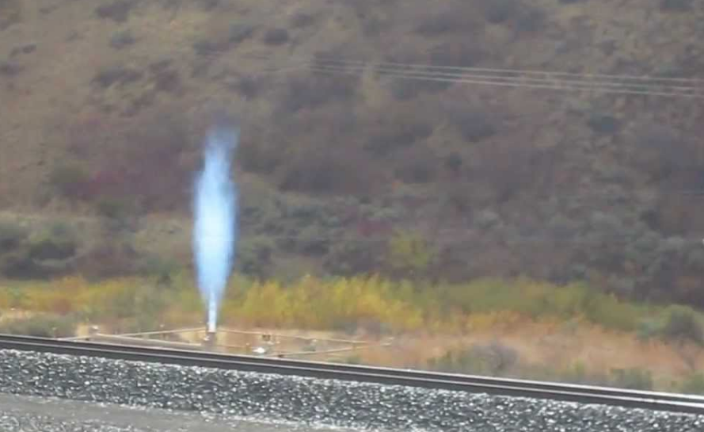
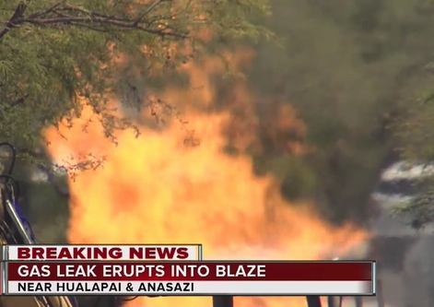
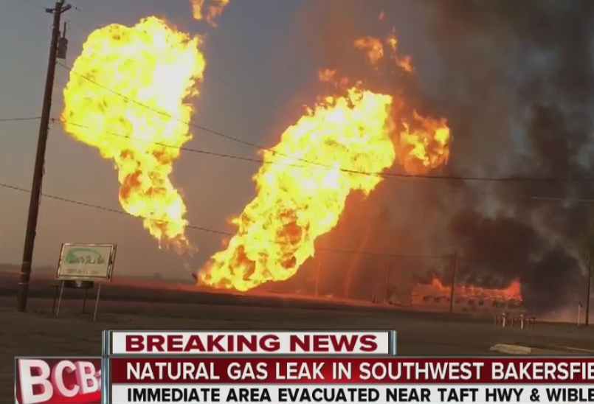
Natural Gas Leaks
youtube.com
youtube.com
ktnv.com

Slide 17
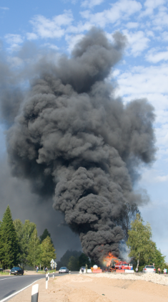
Law Enforcement Response
Check wind direction and stay upwind.
Deny access to the area and evacuate all people in the affected area based on fire department recommendations or refer to Guide 115 in the Emergency Response Guidebook.
Detour traffic.
Locate potential witnesses that may give insight if illegal activity was the cause.

Slide 18
Training Objectives
Define “hazardous materials” and the risks associated with them during a hazardous materials incident.
Describe the duties of an awareness-level first responder at the scene of a hazardous materials incident.

Slide 19
Training Objectives
List methods used to recognize the presence of a hazardous material, to include the identification of the possible material or substance based on readily available clues.
Demonstrate the ability to use the DOT Emergency Response Guidebook in identifying a hazardous material and appropriate first responder actions, to include notifying additional resources.

Slide 20
Training Objectives
Explain what WISER is and how to use it as a resource when at the scene of a suspected hazardous materials incident.
Identify the occurrence of a natural gas leak and what protective measures to take to assure life safety until the leak can be mitigated.

Slide 21
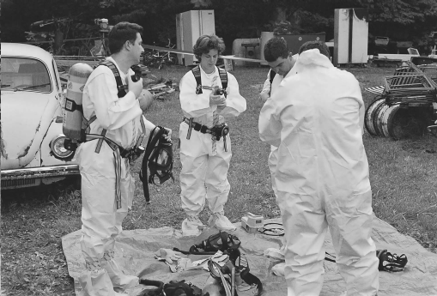
Questions

